Slide 1

1

Slide 2
MONETA
GAME MANAGEMENT
SYSTEM
2

Slide 3
PRESENTATION BY
Faysal Mahmud
ID: 180041117
Ashraful Islam
ID: 180041122
Atiqur Rahman
ID: 180041123
3

Slide 4
MOTIVATION
4

Slide 5
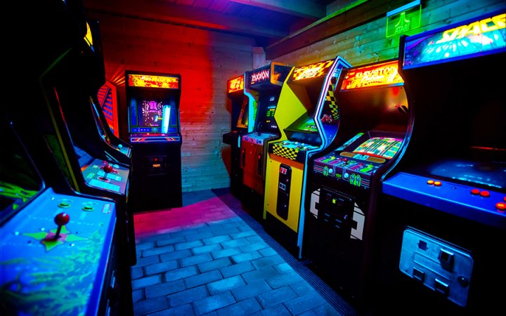
ARCADE
5

Slide 6
OBJECTIVES
6

Slide 7
O B J E C T I V E S
LESS MENPOWER
MORE PROFIT
AWESOME
OWNER’S AUTHORITY
6
4
GAME MANAGEMENT
2
FLUENT & FLEXIBLE
EXPLOITATION
5
1
3
7

Slide 8




FEATURES
MONETA
GAME LIST
Moneta replaces the coin in our system
Different types of amazing small games
MONETA
GAME LIST
PLAY & WIN
PLAY & WIN
SECURITY
SECURITY
Make the high score & win the reward
Secure interface for safe Moneta transaction
8

Slide 9
OLD TIMELINE
2 week
2 week
1 week
2 week
2 week
Login & User Interface
Games
Game edit
Moneta Counter
Score Counter
9

Slide 10
T I M E L I N E
DEVELOP A FUNCTION game_list() WHICH SHOW THE LIST OF GAMES
DEVELOPING 3 GAMES & HEADER FILE TO MANAGE IT
3 WEEKS
2 WEEKS
2 WEEKS
1 WEEKS
3 WEEKS
CREATING user_interface.h FOR LOGIN ID, PASSWORDS & ACCESS PERMISSION
CREATING counter.h FOR COUNTING MONETA & HIGHSCORE
CREATING CLEAR USER INTERFACE,
DEBUGGING, ADDING PACMEN
10

Slide 11
FUTURE WORK
DATABASE
GAME QUALITY
CENTRAL HUB
ONLINE PLATFORM
11

Slide 12
PROJECT DEMO
12

Slide 13
ONE MORE THING !!
13

Slide 14

WE ARE COLLABORATING…
NOT PURCHASING !!!
14

Slide 15
THANKS
15

